Slide 1
WHAT WILL HAPPEN
?
?
?
?
?
?
?
?
?
?
?
?

Slide 2
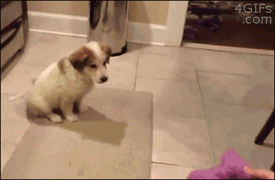

Slide 3
If the owner throws the toy,…
A the dog will fall.
B the dog will run away.
C the dog will do nothing.

Slide 4
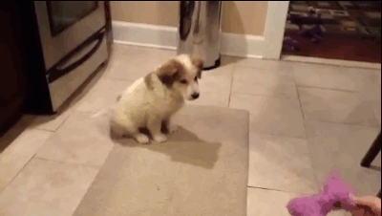

Slide 5
If the owner throws the toy,…
A the dog will fall.
B the dog will run away.
C the dog will do nothing.

Slide 6
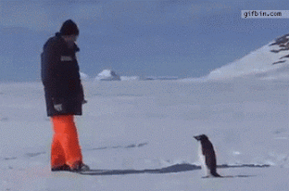

Slide 7
If the man takes another step,
A the penguin will hug the man.
B the penguin will jump in the air.
C the penguin will attack the man.

Slide 8
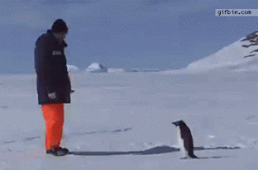

Slide 9
If the man takes another step,
A the penguin will hug the man.
B the penguin will jump in the air.
C the penguin will attack the man.

Slide 10
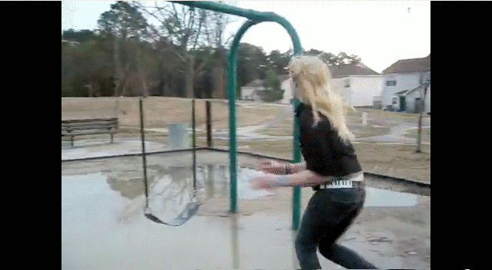

Slide 11
If the girl jumps on the swing,
A she will get the swing in her face.
B she will jump next to it.
C she will fall into the puddle.

Slide 12
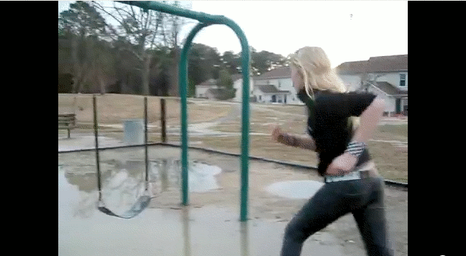

Slide 13
If the girl jumps on the swing,
A she will get the swing in her face.
B she will jump next to it.
C she will fall into the puddle.

Slide 14
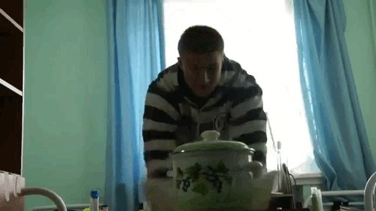

Slide 15
If the man pulls the tablecloth,
A the pot will fall on the ground.
B a cat will jump out of the pot.
C the closet will fall down on him.

Slide 16
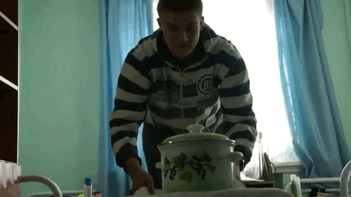

Slide 17
If the man pulls the tablecloth,
A the pot will fall on the ground.
B a cat will jump out of the pot.
C the closet will fall down on him.

Slide 18
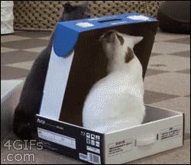

Slide 19
If the grey cat sees the white cat,
A the grey cat will jump in the air.
B the grey cat will close the box and sit on it.
C the white cat will attack the grey cat.

Slide 20
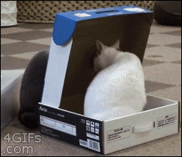

Slide 21
If the grey cat sees the white cat,
A the grey cat will jump in the air.
B the grey cat will close the box and sit on it.
C the white cat will attack the grey cat.

Slide 22
Examples:
If the owner throws the toy, the dog will fall down.
If the man takes another step, the penguin will attack him.
If the girl jumps on the swing, she will fall into the puddle.
If the man pulls the tablecloth, the closet will fall down on him.
If the grey cat sees the white cat, he will close the box and sit on it.

Slide 23
if clause
main clause
If the owner throws the toy, the dog will fall.

Slide 24
If + present simple + , + will/won’t + infinitive
If the owner throws the toy, the dog will fall.
The dog will fall, If the owner throws the toy.
First conditional

Slide 25
Try yourself

Slide 26
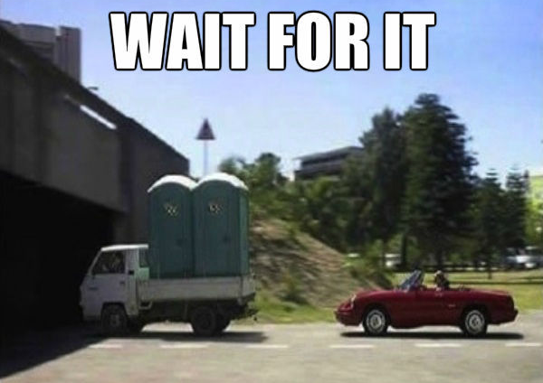
the car/if/underneath the bridge/drives/,/will/on the convertible/fall/the toilets/
If the car drives underneath the bridge, the toilets will fall on the convertible.

Slide 27
bronnen
4gifs.com
gifbin.com

